Slide 1
Capstone Project Presentation Deck
Group No. 1 - Predicting Customer Acquisition Cost for a Retail Chain
Group Members
1.Abhishek Khanra
2.Akshen Dhami
3.Harshal Hinge
4.Ritesh Bhandari
5.Yash Rajendra Jadhav

Slide 2
Before Midterm Presentation

Slide 3
Introduction to Problem Statement
The Convenience Food Mart is a chain of 300-odd convenience stores all across the United States of America. In order to acquire 1 customer from the potential consumers of products in food, drinks and non-consumable categories (Cleaning, Electricals, etc.), what is the cost (spend) on the media channels (Radio, TV, Newspapers, In-store coupons etc.)

Slide 4
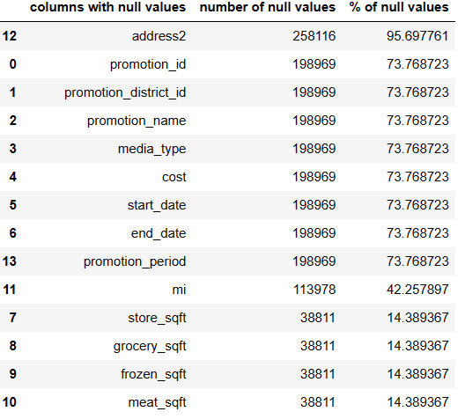
Project Life Cycle
Data Collection
Dataset Link :Dataset Link (master), Dataset Link (Base)
Merge 8 tables (product, customer, product_class, promotion, region, sales, time_by_day and store.
Shape : rows:269720, columns:95
Data Cleaning
Dropped 2 columns with 100% null values
14 columns with null values
Since target column (“cost”) had 73% null values
Dropped rows based on cost, resulting in 70,751 rows.
Assignment of correct datatypes (which were already encoded or nominal data) – resulting in 21 numerical columns, 73 categorical columns

Slide 5
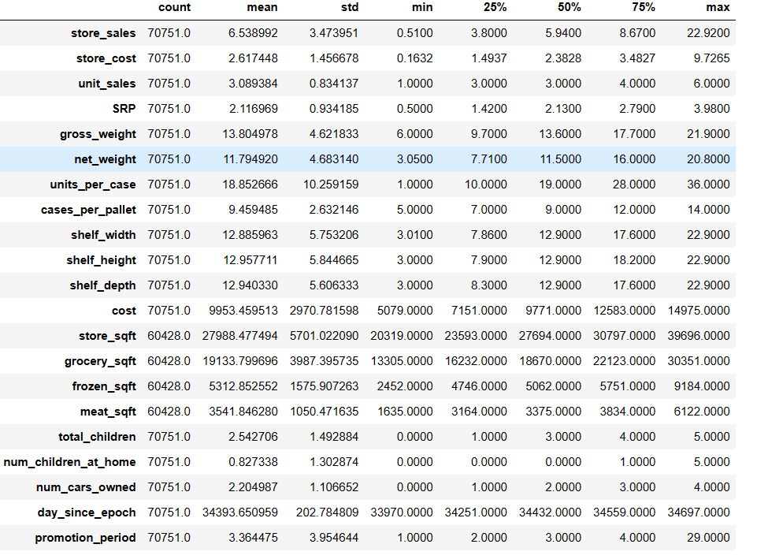
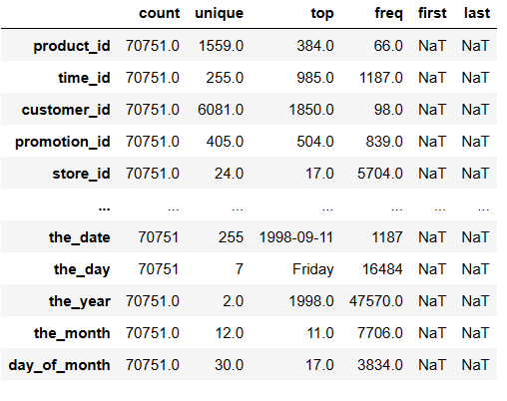
Exploratory Data Analysis
5 point summary

Slide 6
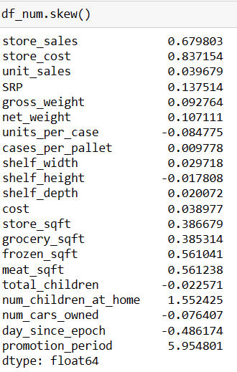
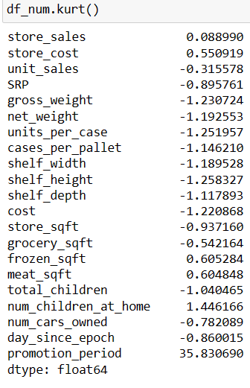
Exploratory Data Analysis
Univariate Analysis

Slide 7
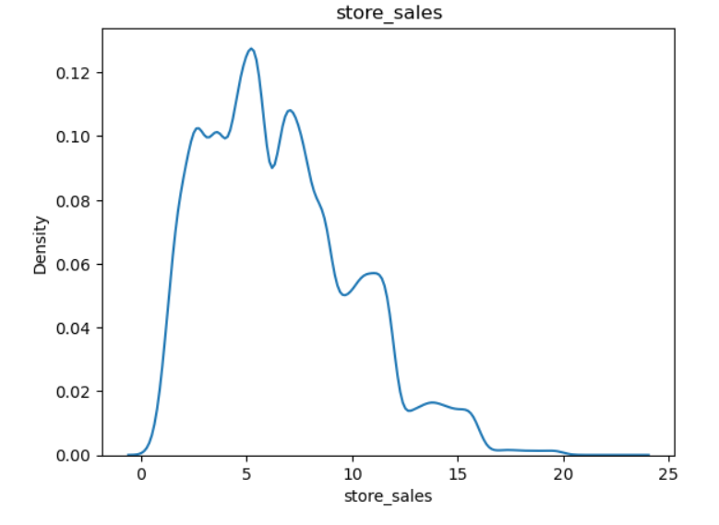
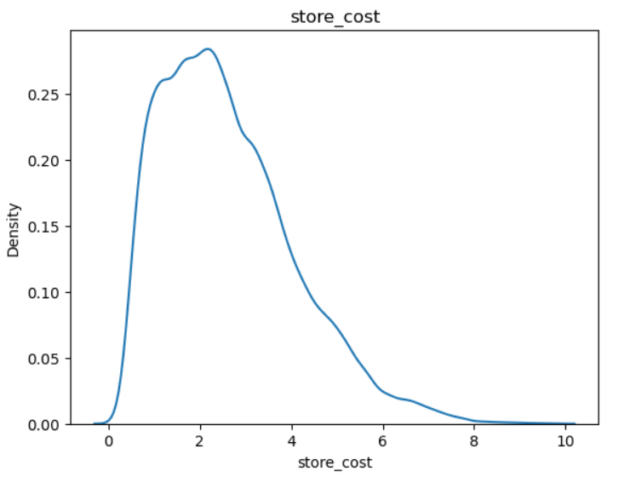
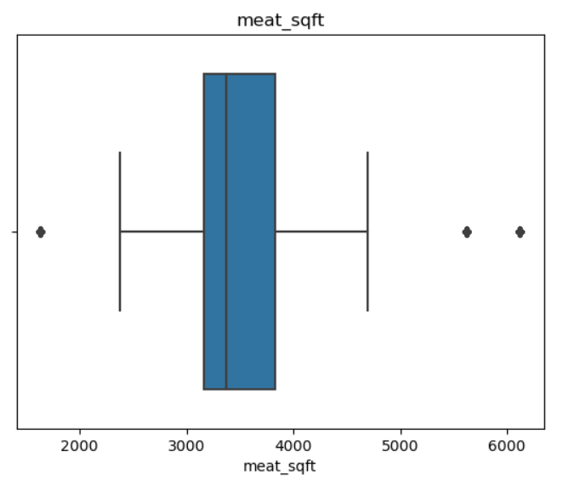
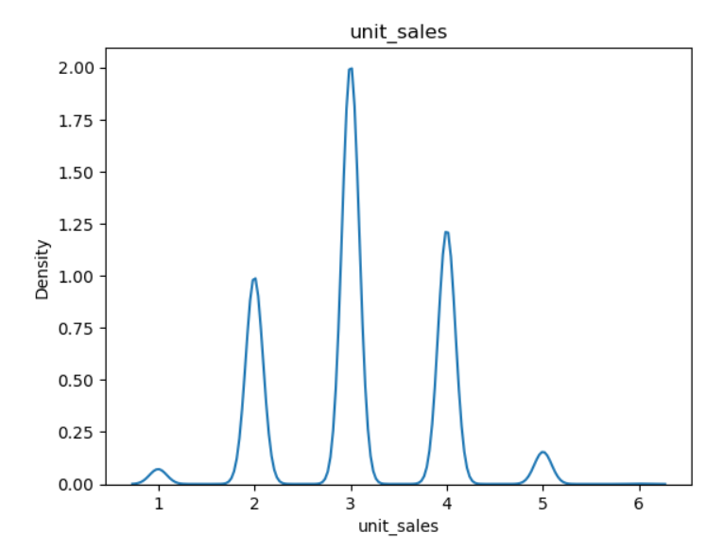
Exploratory Data Analysis

Slide 8
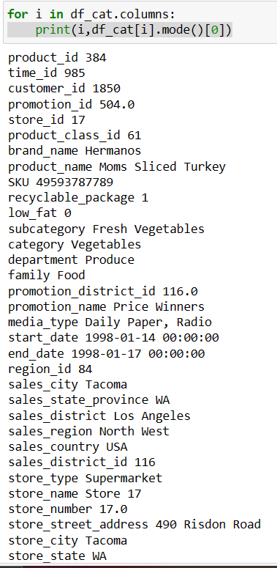
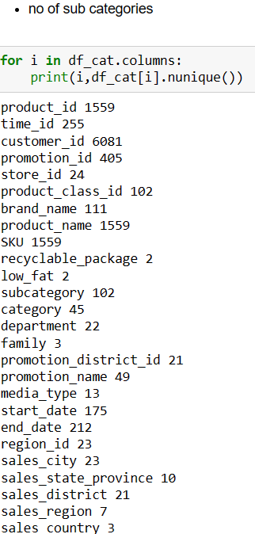
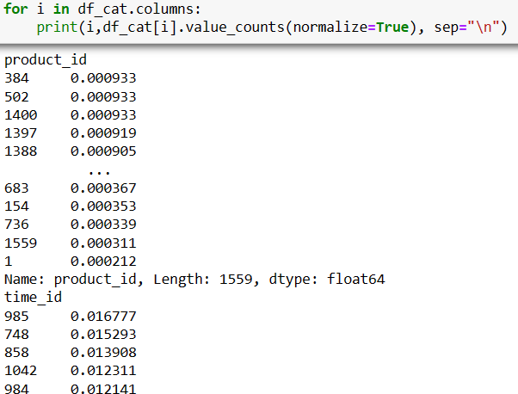
Exploratory Data Analysis

Slide 9
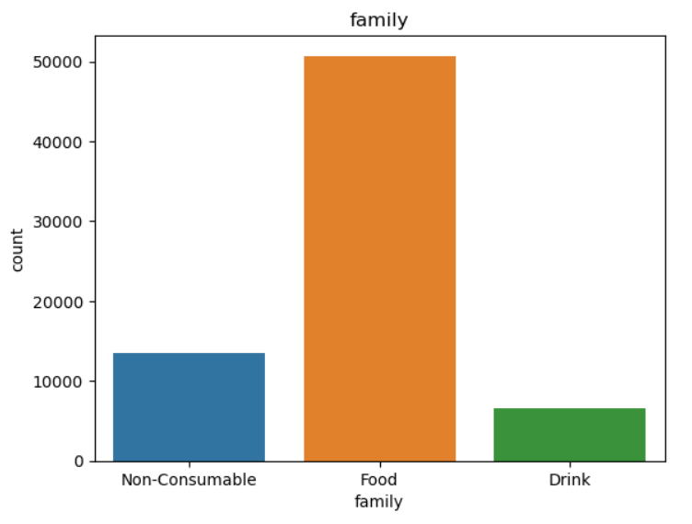
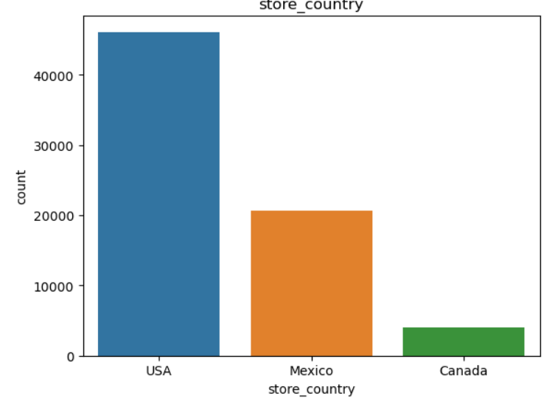
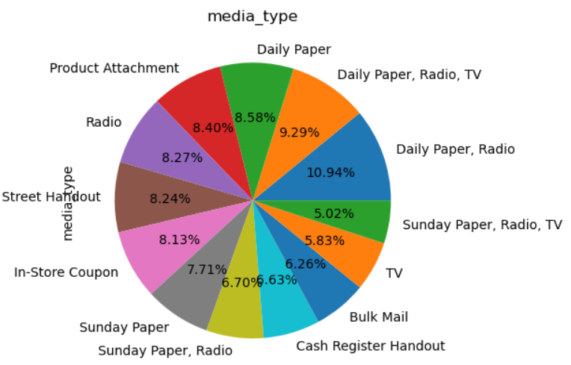
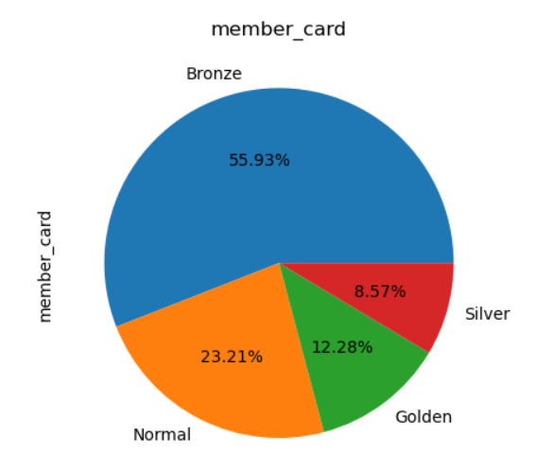
Exploratory Data Analysis

Slide 10
Data Preprocessing
Null value imputation – 4% null values for 2 columns (median imputation)
One hot encoding
Outlier treatment/Scaling/Transformation – not attempted
Feature Engineering – Promotion_period (last_date – first_date)
Feature Selection – 2 attempts
Attempt 1 - dropping id columns, address, date columns
Attempt 2 – apart from attempt 1, dropping name columns ( customer_name, product_name, etc.)

Slide 11
Model Building
Linear Regression (to act as baseline as the model not good for a dataset with large number of categorical columns)
Decision Tree Regressor
Random Forest Regressor
Ada Boost Regressor
Gradient Boosting Regressor
XG Boost Regressor
Stacking – 1 [base- [Decision Tree Regressor, XG Boost Regressor ] final- [Random Forest Regressor]
Stacking – 2 [base-[Decision Tree Regressor, Random Forest Regressor], final- [XG Boost Regressor]

Slide 12
Model Performance – Metric - MSE
Model selection – DT,XGB, Stacking 2

Slide 13
Conclusion and Further Steps
Challenges faced
ideal mix between low and near equal test train mse and low cross validation mse
High model computation time because of larger number of categorical columns (having large number of subcategories) for the usage of robust models. Especially for cross validation and hyperparameter tuning via RandomizedSearchCV and GridSearchCV.
Further steps:
Usage of Label encoding in case issue of large computational time persists.
Using stacking where no hyperparameter tuning is needed (except if you wish to do so for final and base estimators)
Further feature selection to 30 or below columns and checking model performance and variance
Kprototype clustering – mixed data to check if we can make meaningful cluster for customers for effective resource utilization.

Slide 14
After Midterm Presentation

Slide 15
Model building via Encoding and Feature Selection
A. Customer Acquisition Cost prediction
After data preprocessing, 56 columns were selected (based on domain) and all 7 models were run for one-hot encoding, dummy encoding and label encoding. The same was repeated for 43 columns (based on domain).
After selecting label encoding, 3 methods of feature selection were used. 31 columns were selected based on domain, SFS (Linear Regression, k_features=”best”) used on a dataset with 56 columns and best columns based on relative importances of best performing model (XGB Regressor) used on a dataset of 43 columns.
The same procedure was repeated for selecting 16 columns for domain and for SFS (k_features=”best” for linear regression on 31 columns dataset resulted in 19 independent columns . SFS was used on that dataset for linear regression from which 15 columns were selected (k_features=15 ) as cost column is target column) and relative importance were calculated on a dataset of 31 columns for XGB Regressor.
21 columns were selected based on domain and SFS (XGB Regressor, k_features=”best”) used on a dataset with 43 columns.

Slide 16
Model building via Encoding and Feature Selection
A. Customer Acquisition Cost prediction
All the models were evaluated using Mean Squared Error (MSE) for train and test data as well as cross-validation score (no of folds=3) for finding the best model with low bias and variance errors.
Binning -For reducing cardinality of categorical columns, similar subcategories were grouped together to reduce the number of subcategories [ department, promotion name] and sales region was selected instead of sales district. The same procedure was repeated for 43, 31, 16 and 21 columns. Thereafter model evaluation was conducted which gave higher bias error and lower variance error as compared to previous technique.
.

Slide 17
Model building via Encoding and Feature Selection
A. Customer Acquisition Cost prediction
All PCA (Principal Component Analysis) was conducted on all 20 independent numerical columns (excluding target column cost) and all 7 models were run and performance was evaluated. PCA components (20) along with 9 categorical columns out of 15 independent columns from XGB model – domain were selected and all 7 models were run and performance was evaluated. Higher bias error and lower variance error was reported as compared to the previous technique.

Slide 18
Clustering Model
B. Clustering – Segmentation – K-Prototype
K-prototype clustering for mixed data (9 categorical and 6 numerical features from XGB-16 model- domain) was conducted. Categorical index was given as input for cluster while numerical columns were scaled (standard scaler) and silhouette score was calculated for finding the ideal number of clusters for a range of 2 to 8 clusters (excluding 8). Since highest silhouette score was highest for number of clusters being 2, the same was used to divide customers into 2 clusters.
Cluster centroids were calculated and visualized using heatmap to define clusters, However, since the numerical data contained a few discrete variables and encoded categorical columns, insights weren’t observed.
5 point summary of both clusters and data visualization of numerical and independent features using clusters as hue (differentiator) provided similarities and differences of customers which provided cluster definition for both clusters.

Slide 19
Model Performance Evaluation
Final model was XGB Regressor model based on dataset of 16 features (15 independent, 1 dependent) out of 94 columns based on domain knowledge (selecting important customer, location, product, promotion and store related features).
Out of all models built, final model had one of the lowest bias error (train MSE- 2661(RMSE -51.58) , test MSE – 3154 (RMSE-56.16)) with the lowest variance error (std (MSE) – 16761 ). Final model had the best bias-variance tradeoff which results in lowest bias(in this case one of the lowest bias) error and lowest variance (in this case lowest variance) error. Thus, the final model is an effective (low bias error) and generalized (lowest variance error) which works well with new and unseen data.
For clustering model, highest silhouette score was 0.209 for no of clusters(k) =2 (for k=2,3,4,5,6,7). The customers were divided into a. price discount searchers buying costlier products and a greater number of products, b. sale day searchers buying cheaper products and a smaller number of products.

Slide 20
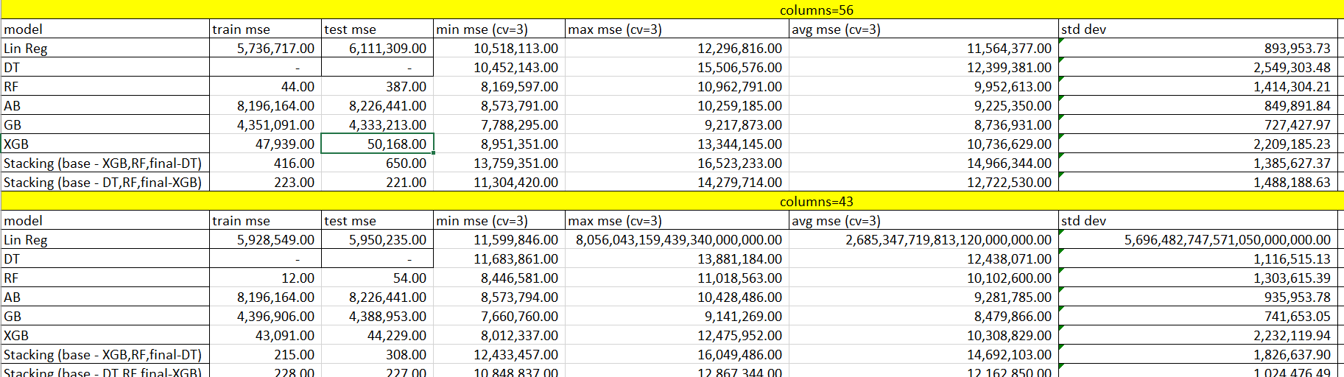
Model Performance Evaluation – Dummy Encoding – 56,43

Slide 21
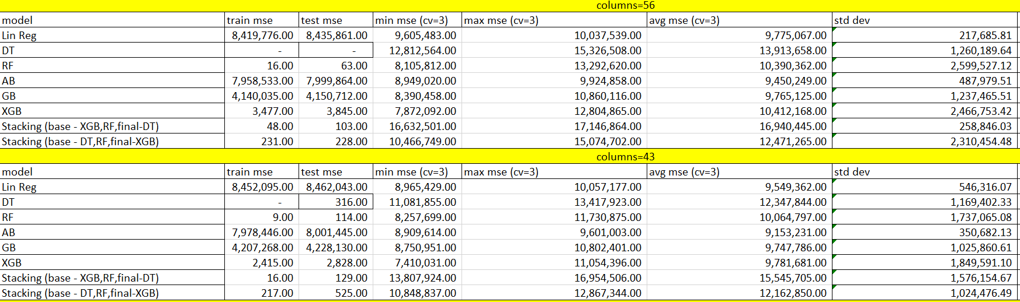
Model Performance Evaluation – Label Encoding -56,43

Slide 22
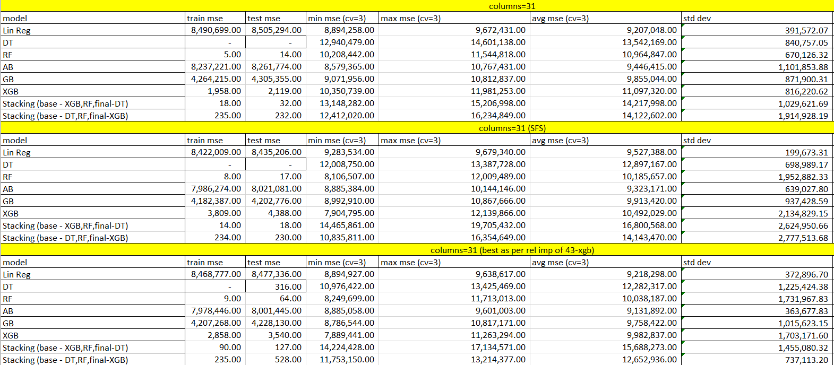
Model Performance Evaluation – Label Encoding -31

Slide 23
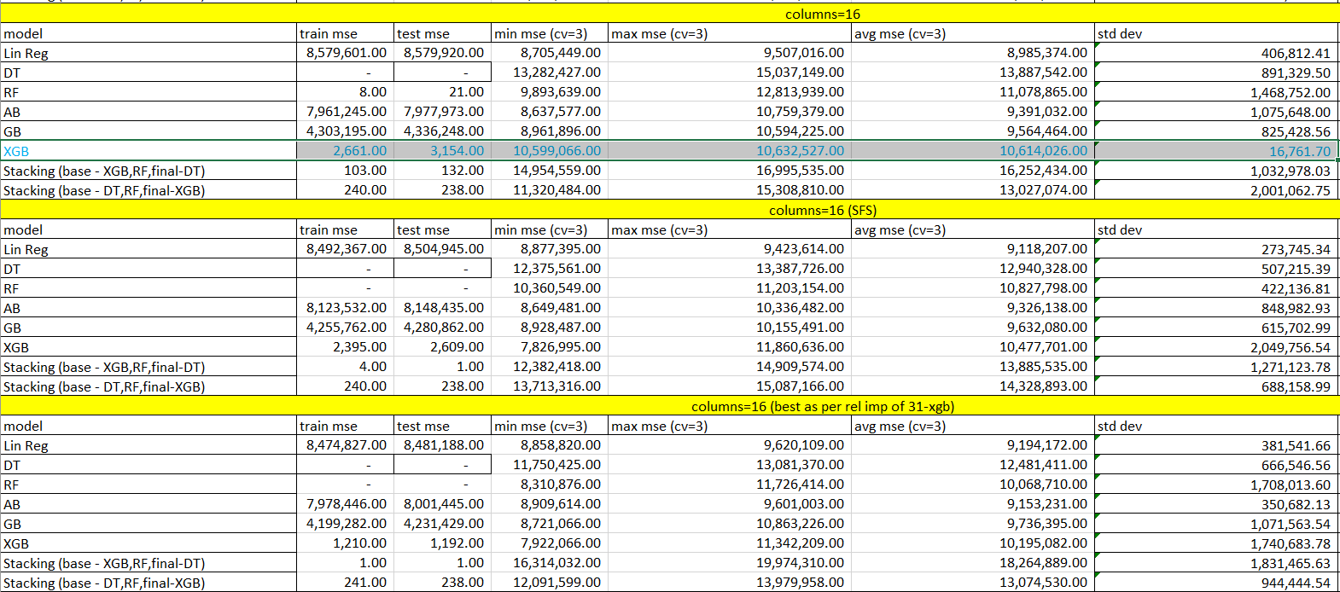
Model Performance Evaluation – Label Encoding -16

Slide 24
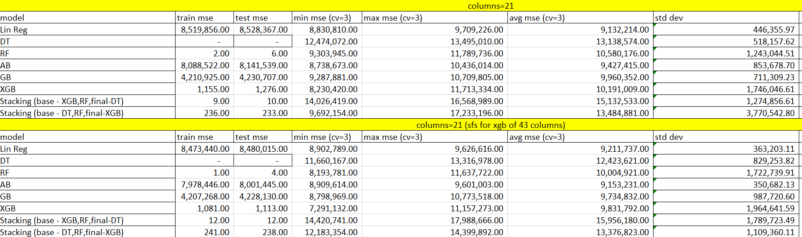
Model Performance Evaluation – Label Encoding -21

Slide 25
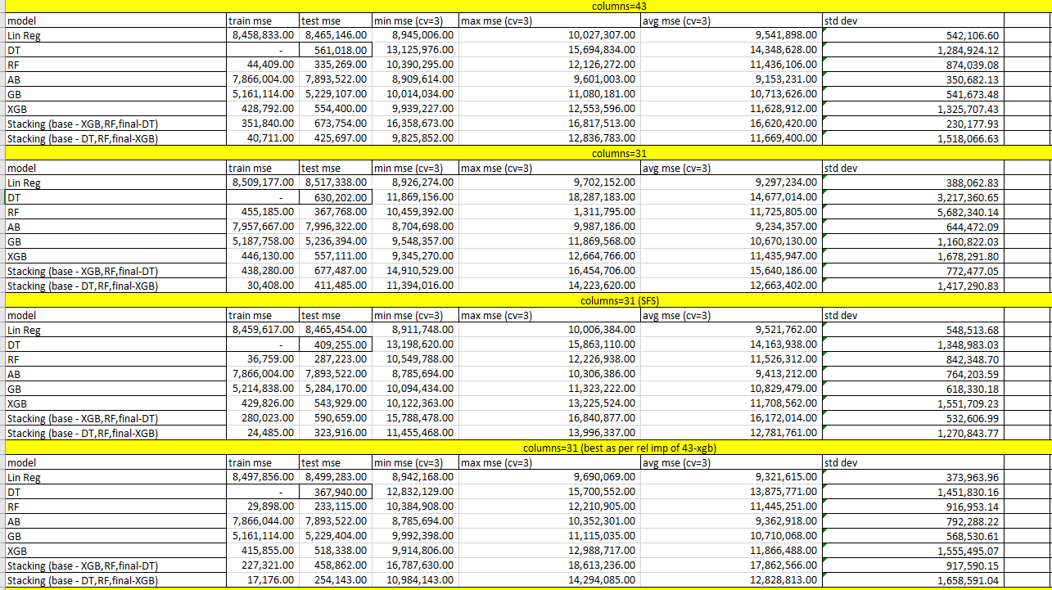
Model Performance Evaluation – BIN -Label Encoding -43,31

Slide 26
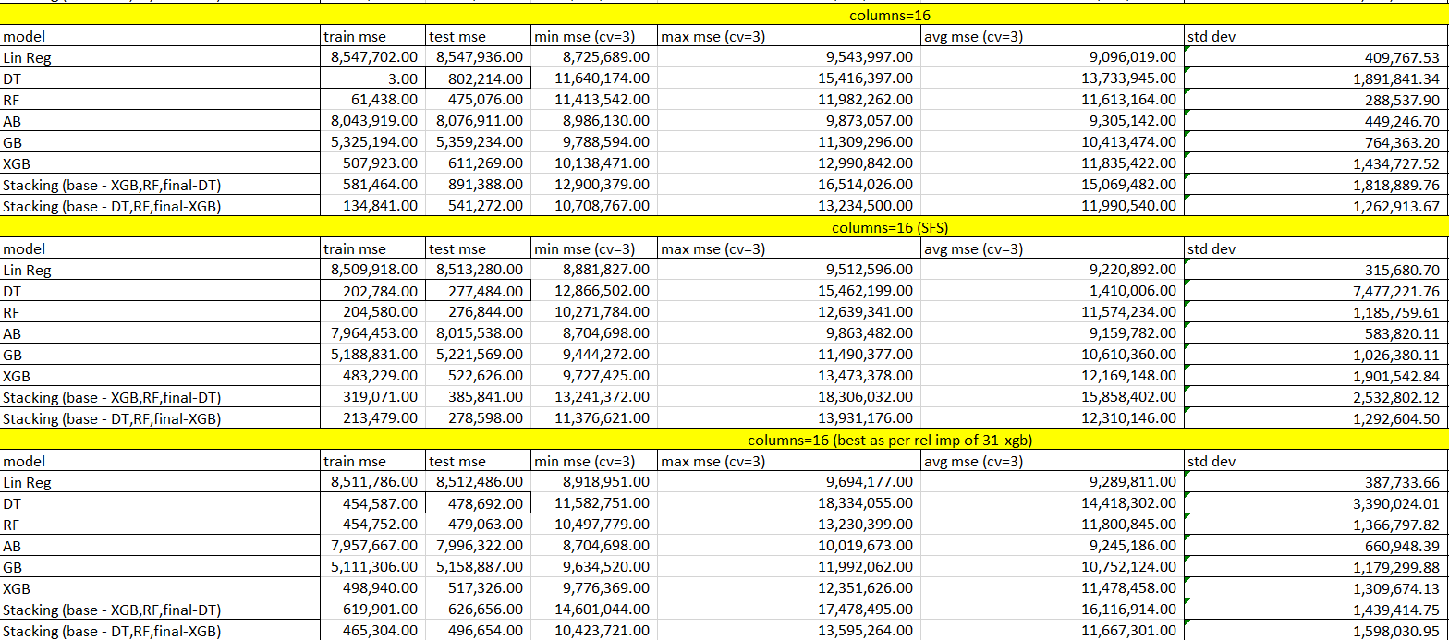
Model Performance Evaluation – BIN -Label Encoding -16

Slide 27
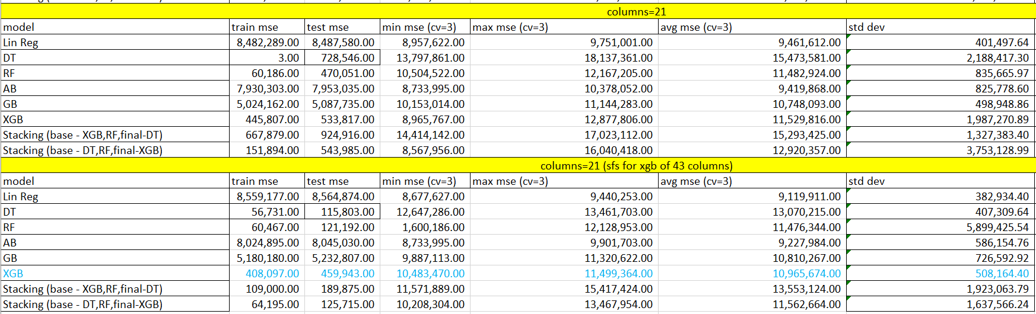
Model Performance Evaluation – BIN -Label Encoding -21

Slide 28
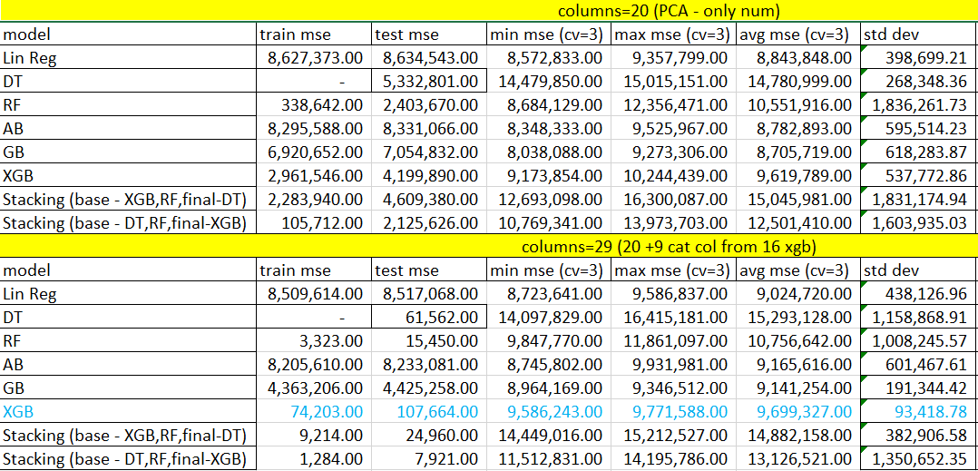
Model Performance Evaluation – PCA -20 and 20+9 CAT

Slide 29
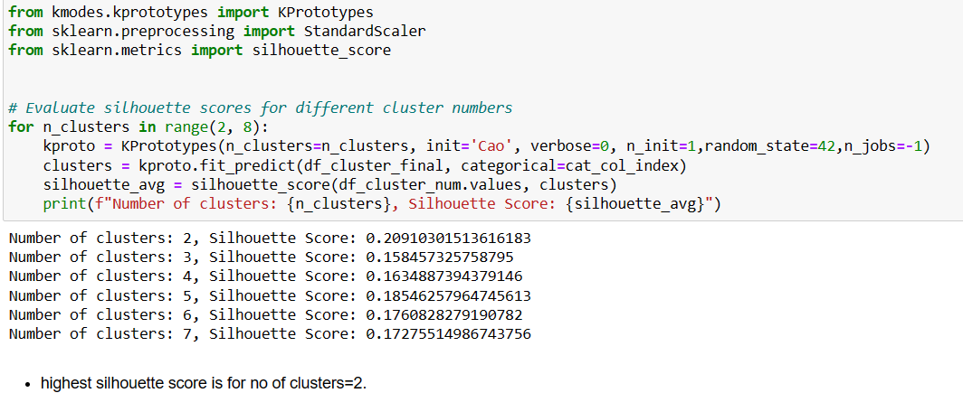
Model Performance Evaluation – k-prototype clustering

Slide 30
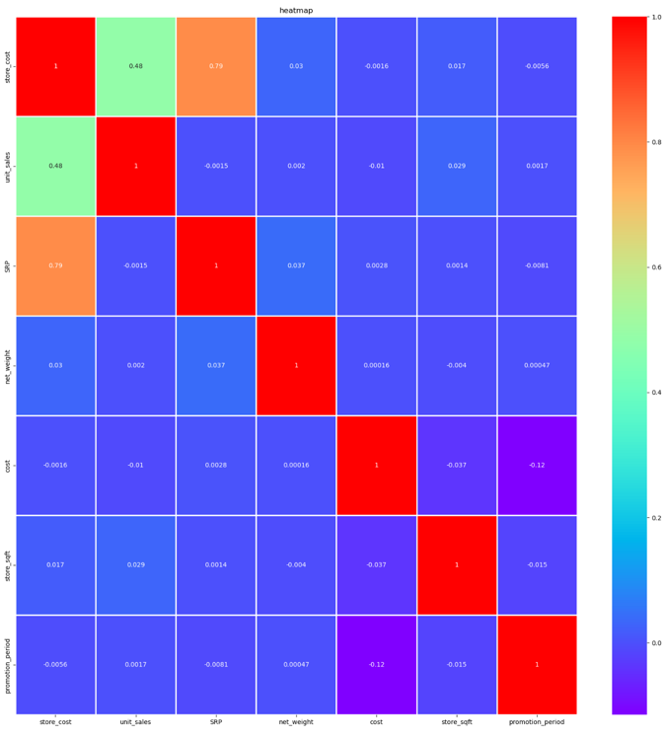
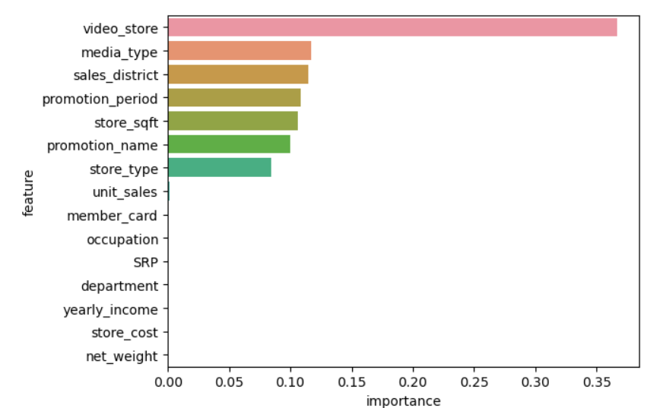
Visualization of features of final model – XGB -16 (domain)

Slide 31
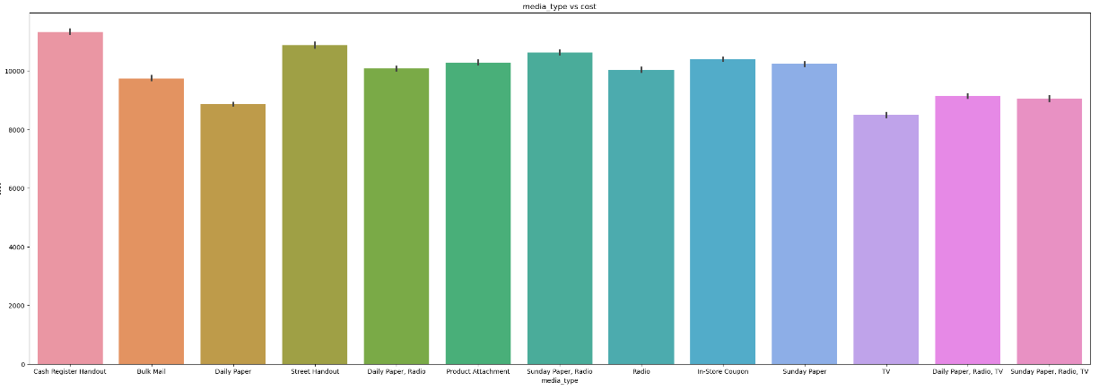
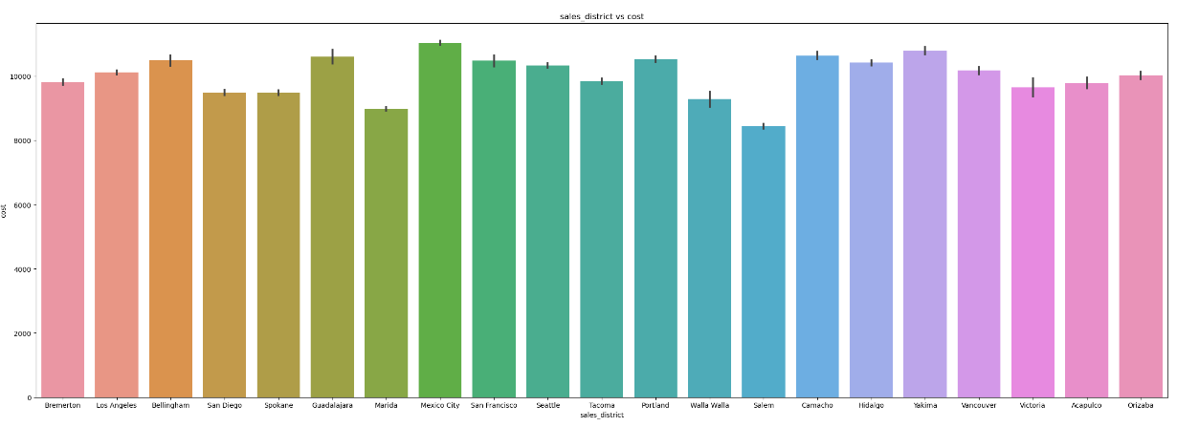
Visualization of features of final model – XGB -16 (domain)

Slide 32
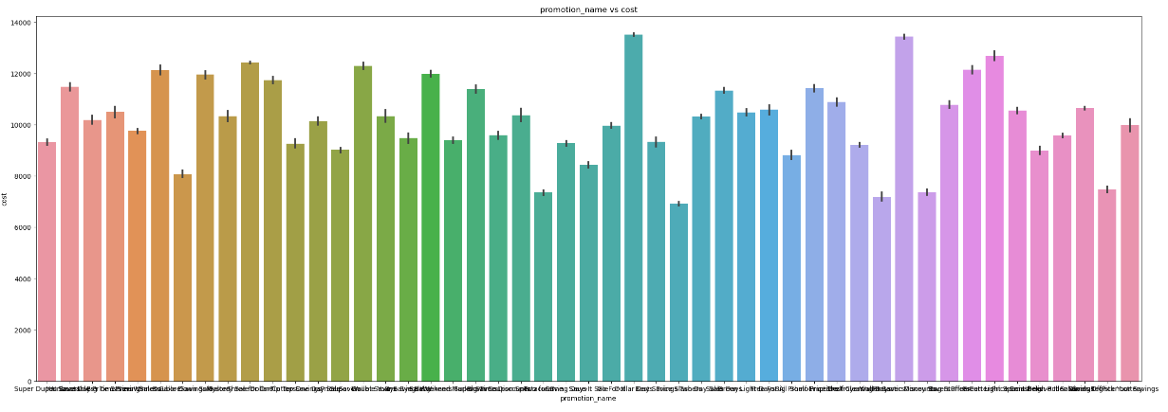
Visualization of features of final model – XGB -16 (domain)

Slide 33
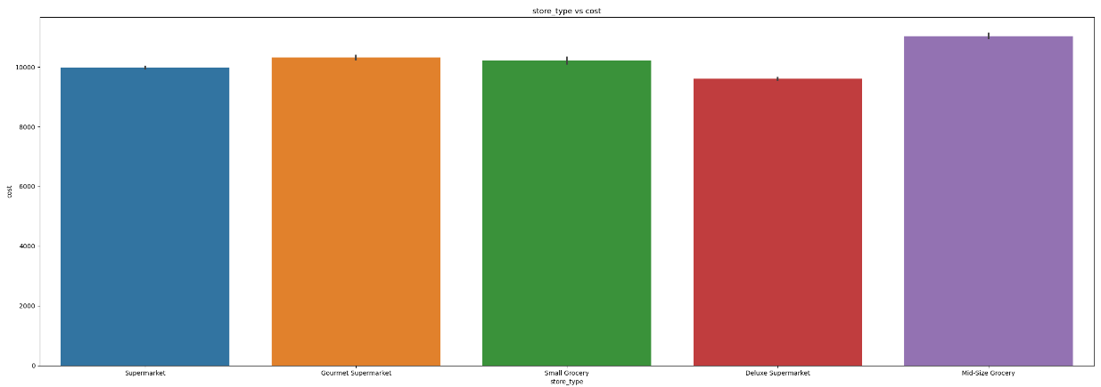
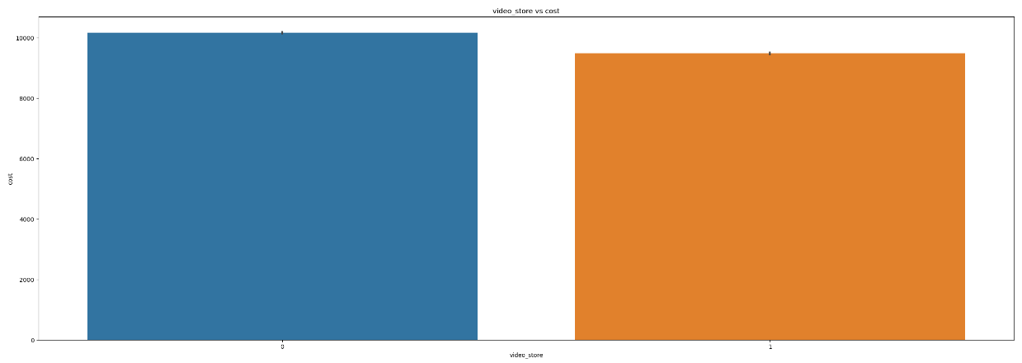
Visualization of features of final model – XGB -16 (domain)

Slide 34
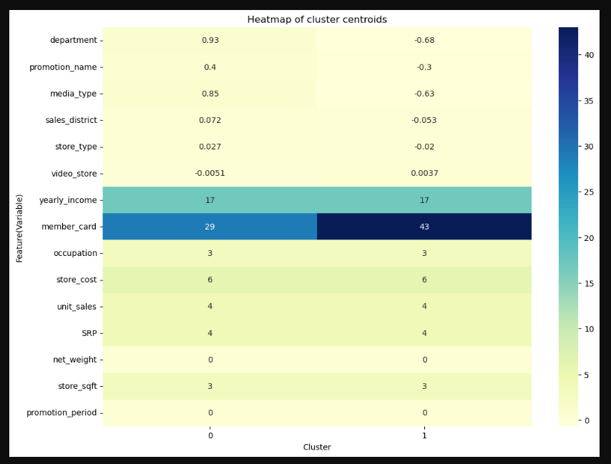
Visualization - clustering

Slide 35
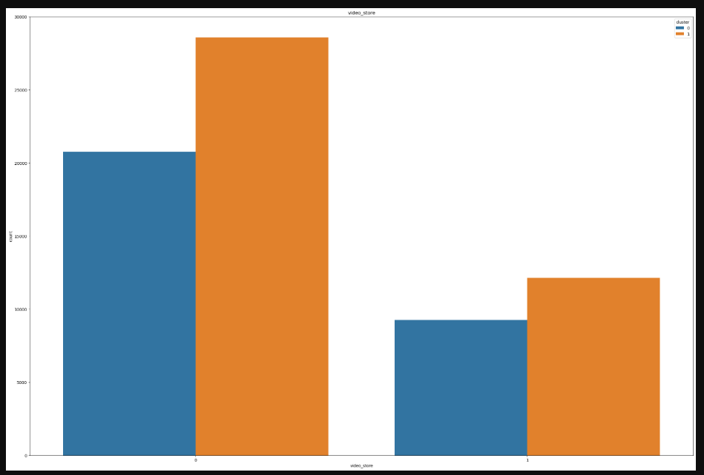
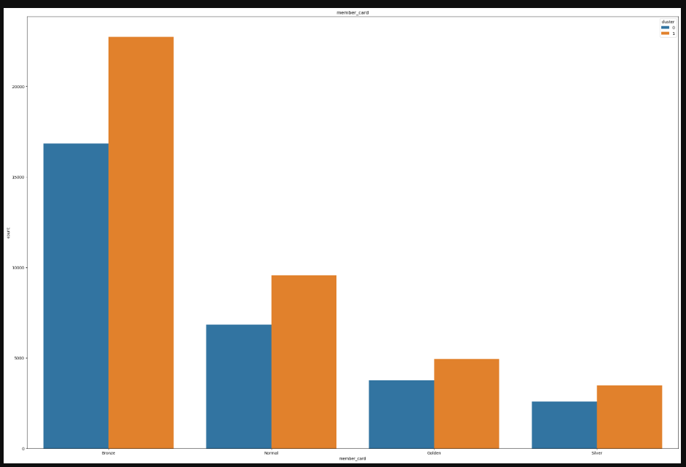
Visualization - clustering

Slide 36
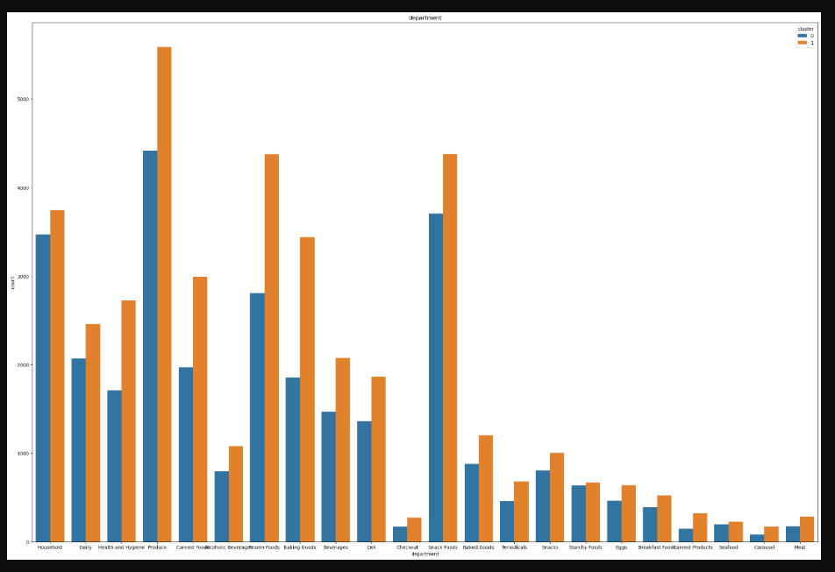
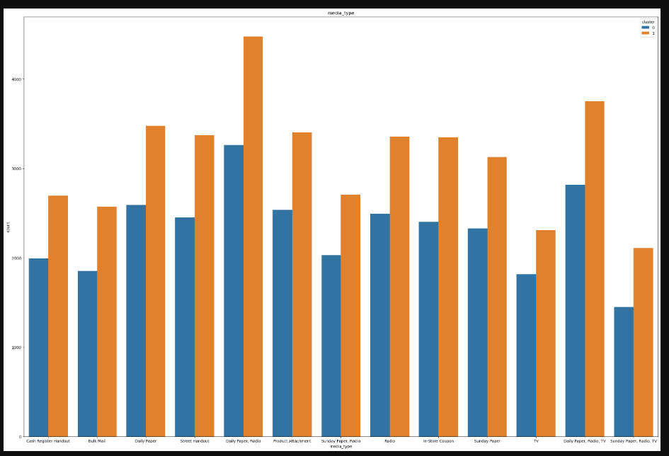
Visualization - clustering

Slide 37
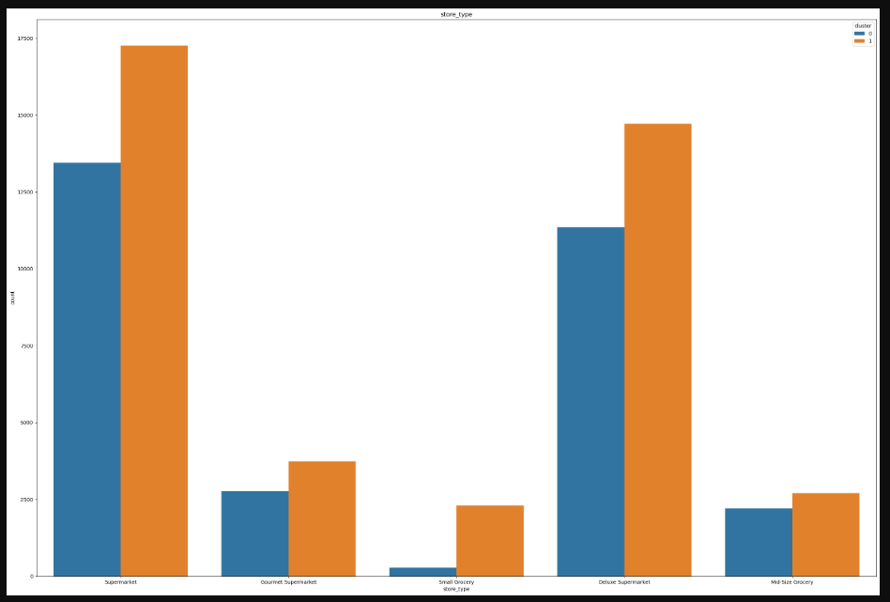
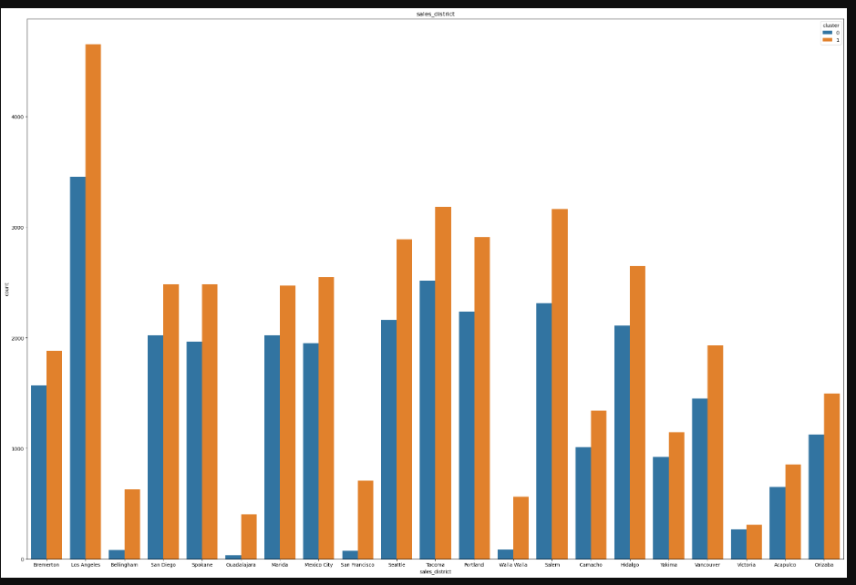
Visualization - clustering

Slide 38
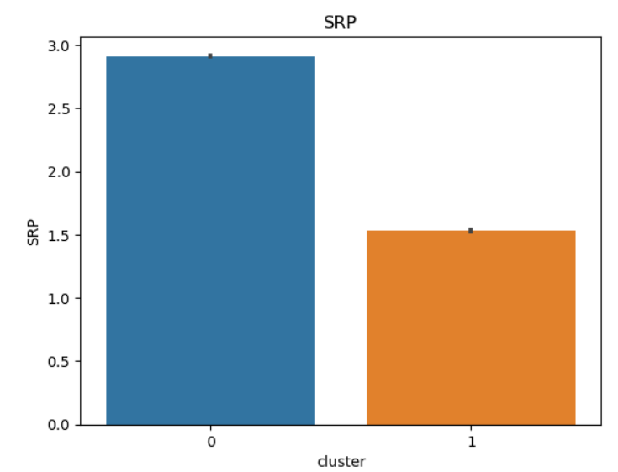
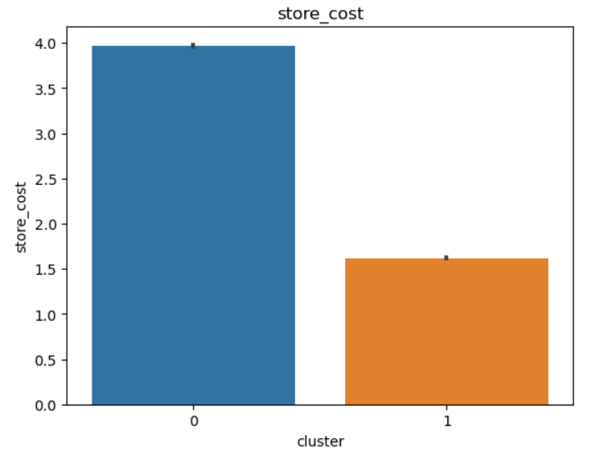
Visualization of features of final model – XGB -16 (domain)

Slide 39
Recommendations
Most important features that are important in predicting customer acquisition cost are video store (presence or absence), media type, sales district, promotion .
Smaller customer acquisition cost for smaller store area.
Reduce promotion period to reduce customer acquisition cost
Stores having video stores to reduce customer acquisition cost
Promotion channel (media type) of Daily Paper, Radio and TV together with respect to Bulk Mail can be used to reduce customer acquisition cost
Promotion method of Cash Register Lottery with respect to Bag Stuffers (discounts on items bought in bulk) can be used to reduce customer acquisition cost
Allott less customer acquisition cost in stores in Bremerton (Washington) with respect to Acapulco (Mexico)

Slide 40
Recommendations
Segmentation of customers into 2 groups can help in subsequent targeting and positioning via different media channels would result in efficient allocation of customer acquisition cost:
Group 1 - price discount searchers buying costlier products and more number of products.
Group 2 - sale day searchers buying cheaper products and less number of products

Slide 41
Limitations of Model
Train and Test MSE are not near zero (51.58 and 56.16 respectively)
The clusters or segments formed are not clearly distinct. Some features are common amongst segments while some features are different. This might result in extra spending of resources while making segment specific plans for acquiring customers.
Promotion channels used in our dataset and hence in our model are from the era of late 90s. Today’s promotion channels are mostly online and hence are easily trackable and thus make marketing promotion spend for acquiring customers more efficient which are not included in our dataset and model.
Real world adjustment to improve solution
For enhancing our solution, we could update our model to include more current promotion channels (include digital) for a solution which is more up to date in real world.

Slide 42
Learnings and potential improvements for next iteration of model
Learnings
Optimal feature selection can provide ideal complexity which provides minimum bias error and variance (data sensitivity) error which results in effective and generalized model.
K-prototype clustering used for mixed data uses distances for scaled numerical data (cluster centroid) and matching dissimilarity(no of dissimilarities for all features in each observation from cluster mode) measure for categorical data(cluster mode).
Potential improvements for next iteration of model
Usage of Hyperparameter tuning for the final model for improving variance error and possibly bias errors (no parameters were used for all models).
Usage of K-Means clustering for numerical features and K-Modes clustering for categorical features and thereafter comparison with K-Prototype clustering done on both numerical and categorical features.

